Slide 1
Session 3
Amy, Judha, Victoria
October, 28, 2022
Notes:
Change the slide background colour to any of the Primary colours (except yellow)

Slide 2
SCOTIABANK DIGITAL BANKING DECK TEMPLATE
Agenda
01
02
03
BoC Policy rate announcement
IPO Market Freeze
Canada Debt Level

Slide 3
BoC Policy Interest Rate Announcement
Notes:
Don’t be afraid to change the background colours! Under the ”design” tab select “format background”. Change the background colour to one of the fun new Scotia colours!

Slide 4
On Oct 26, BoC announced another 50 bps increase on policy interest rate
3.75%
4%
3.75%
Current overnight rate
Current Bank Rate
Current Deposit Rate
Notes:
Borrowing rates are up, We are more and more feeling the cost of borrowing
We are more discouraged from borrowing but saving
Overnight rates are the rates at which banks lend funds to each other at the end of the day in the overnight market.
bank rate is the interest rate at which a nation's central bank lends money to domestic banks, often in the form of very short-term loans.

Slide 5
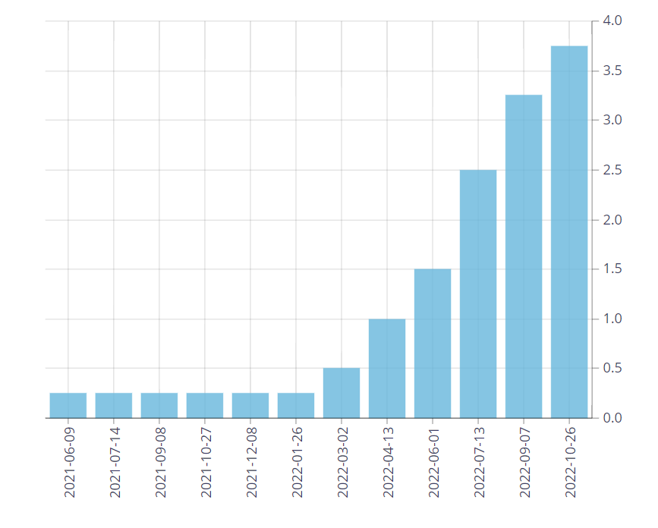
Interest Rate Hike data
00 SUBSECTION NAME
Since March 2022, there has been overnight rate increase to fight against inflation
Nevertheless, Wednesday’s rate announcement shows effective economic slowdown. Housing demand has retrieved seemingly, and our spending s has decreased
Notes:
Since the beginning of the year, with shortage of supply and we are facing excess of demand for goods and , we are facing sharp inflation
How much higher it will go depends on how the monetary policy is working , the supply is recovering back, and how we expect price is going to rise
We will expect another rise in interest rate to further slow down the demand and recover the economy

Slide 6
02
The IPO Market Freeze

Slide 7
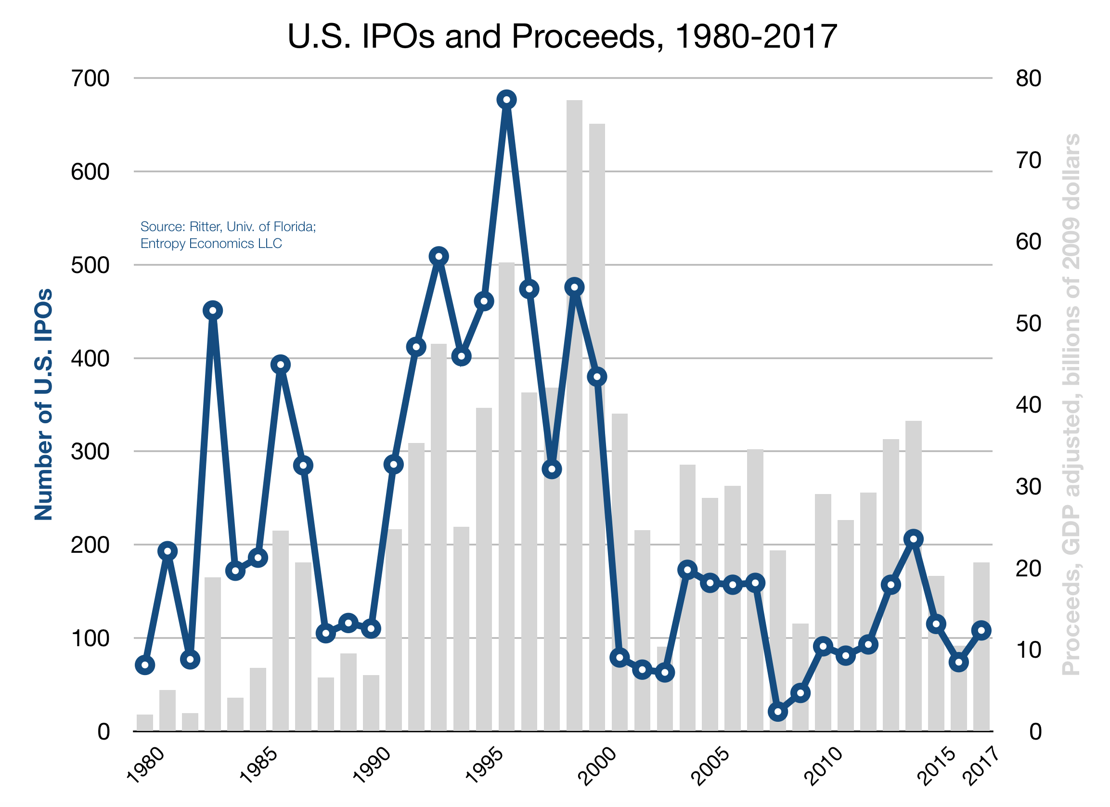
00 SUBSECTION NAME
7
7
What is an IPO?
An IPO is the process of a private company issuing public stock for the first time
Allows the company to raise capital through equity
Presents an opportunity for public investors and institutions to buy into the company
Provides liquidity for initial investors to sell their ownership in the form of stock
Companies will seek investment banks to carry out the IPO and “book building” process
A look at U.S. IPOs and proceeds history …

Slide 8
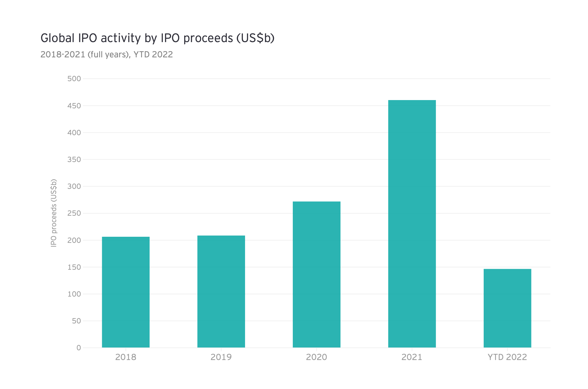
00 SUBSECTION NAME
8
8
IPO Slowdown
Since the start of the year, markets have seen a slowdown in IPOs
Inflation is high and markets are volatile
Investors are opting for safer low-risk investments, thus proceeds raised through IPOs have been significantly lower than previous years
Private companies are postponing going public
They may opt to seek funding in other ways (in the private market, using debt, etc.)
Global IPO volumes have fallen 44% YTD 2022
Source: EY’s IPO Trend Report
Global IPO Volumes fell significantly this year
As Q3 comes to a close, IPO activity is low in comparison

Slide 9
03
Canadian debt levels
Notes:
Don’t be afraid to change the background colours! Under the ”design” tab select “format background”. Change the background colour to one of the fun new Scotia colours!

Slide 10
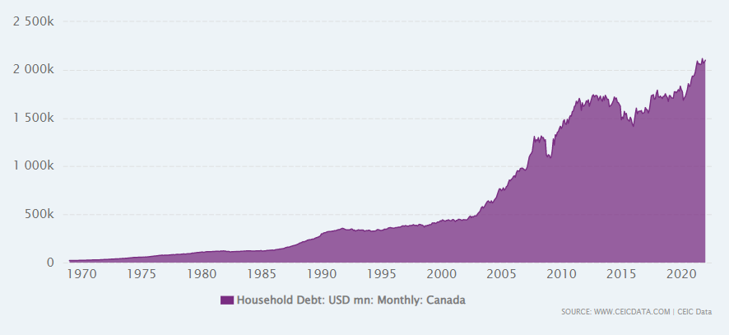
00 SUBSECTION NAME
Canada's Household Debt from Jan 1969 to Jul 2022
With interest rates increasing, does an ever-growing debt mountain make Canadians worry?
2/3rds is mortgage. Rest is split on credit card and other debt

Slide 11
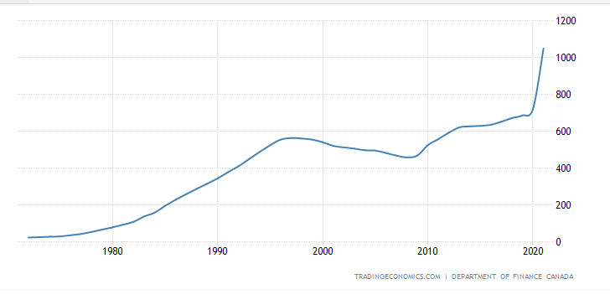
00 SUBSECTION NAME
11
11
Government Debt in Canada increased to 1048.75 CAD Billion in 2021 from 721.36 CAD Billion in 2020
Consumer and government debt both hit all time highs these past few years, will it matter?

Slide 12
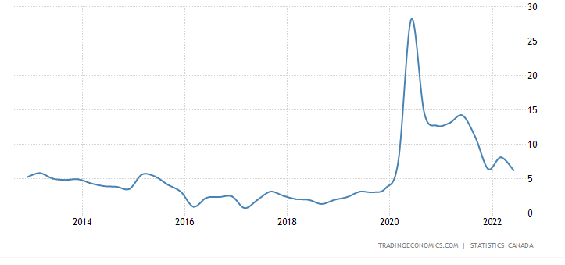
00 SUBSECTION NAME
Household Saving Rate in Canada decreased to 6.20 percent in the second quarter of 2022 from 8.10 percent in the first quarter of 2022
Savings rate going down, still higher than average
What happens if we get a deep recession?
Job losses? Higher debt?
Hope for a soft one.

Slide 13

04
Bonus

Slide 14
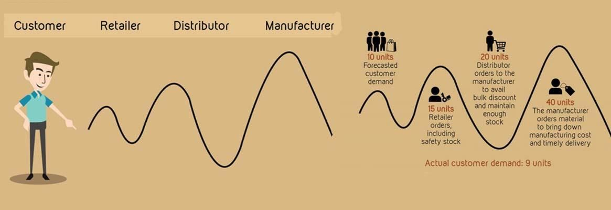
00 SUBSECTION NAME
Why Everything Is On Sale: The Bullwhip Effect
https://www.youtube.com/watch?v=sZnxWVKhObo
Interested in a good sale?
Notes:
https://www.youtube.com/watch?v=sZnxWVKhObo

Slide 15
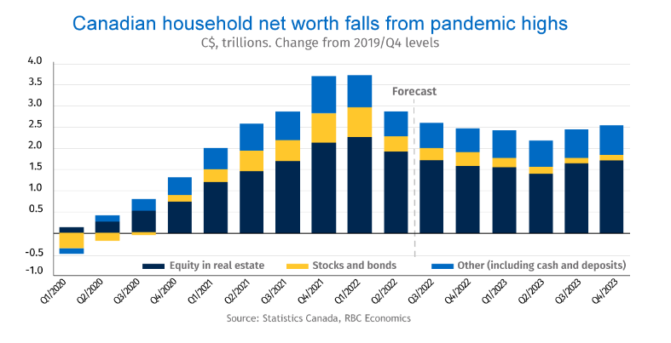
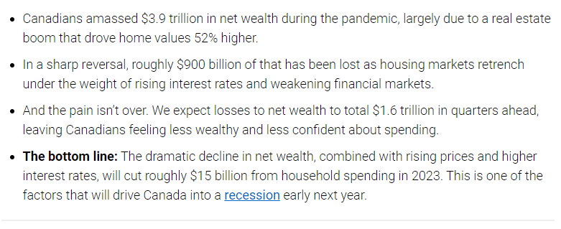
00 SUBSECTION NAME
“The housing-charged boom in Canadian net wealth is over”
- RBC - Nathan Janzen and Carrie Freestone
https://thoughtleadership.rbc.com/proof-point-the-housing-charged-boom-in-canadian-net-wealth-is-over/
Notes:
https://thoughtleadership.rbc.com/proof-point-the-housing-charged-boom-in-canadian-net-wealth-is-over/

Slide 16
Thank you

